Slide 1

Heapsort
Notes:
‹#›

Slide 2
Special Types of Trees
Def: Full binary tree = a binary tree in which each node is either a leaf or has degree exactly 2.
Def: Complete binary tree = a binary tree in which all leaves are on the same level and all internal nodes have degree 2.
4
1
3
2
16
9
10
14
8
7
12
Full binary tree
4
1
3
2
16
9
10
Complete binary tree
‹#›
Notes:
‹#›

Slide 3
Definitions
Height of a node = the number of edges on the longest simple path from the node down to a leaf
Level of a node = the length of a path from the root to the node
Height of tree = height of root node
4
Height of root = 3
1
3
Height of (2)= 1
2
16
9
10
Level of (10)= 2
14
8
‹#›
Notes:
‹#›

Slide 4
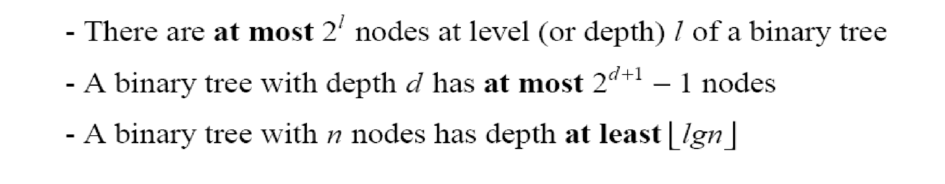
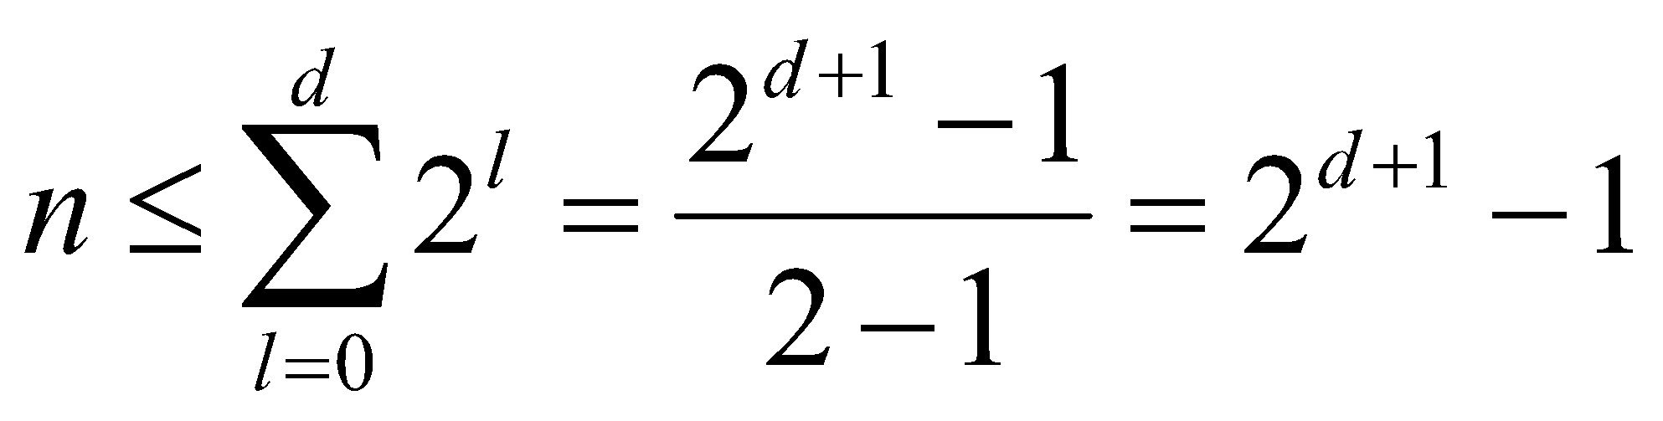
Useful Properties
height
height
(see Ex 6.1-2, page 129)
4
Height of root = 3
1
3
Height of (2)= 1
2
16
9
10
Level of (10)= 2
14
8
‹#›
Notes:
‹#›

Slide 5
The Heap Data Structure
Def: A heap is a nearly complete binary tree with the following two properties:
Structural property: all levels are full, except possibly the last one, which is filled from left to right
Order (heap) property: for any node x
Parent(x) ≥ x
From the heap property, it follows that:
“The root is the maximum
element of the heap!”
8
7
4
5
2
Heap
A heap is a binary tree that is filled in order
‹#›
Notes:
‹#›

Slide 6
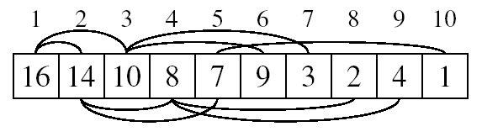
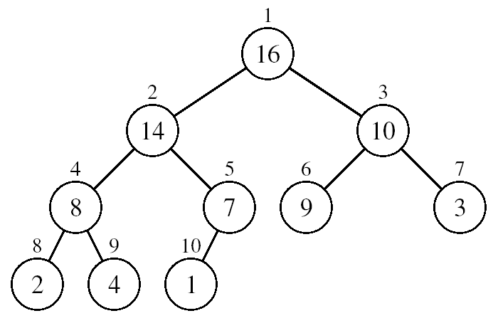
Array Representation of Heaps
A heap can be stored as an array A.
Root of tree is A[1]
Left child of A[i] = A[2i]
Right child of A[i] = A[2i + 1]
Parent of A[i] = A[ ⎣i/2⎦ ]
Heapsize[A] ≤ length[A]
The elements in the subarray A[(⎣n/2⎦+1) .. n] are leaves
‹#›
Notes:
‹#›

Slide 7
Heap Types
Max-heaps (largest element at root), have the max-heap property:
for all nodes i, excluding the root:
A[PARENT(i)] ≥ A[i]
Min-heaps (smallest element at root), have the min-heap property:
for all nodes i, excluding the root:
A[PARENT(i)] ≤ A[i]
‹#›
Notes:
‹#›

Slide 8
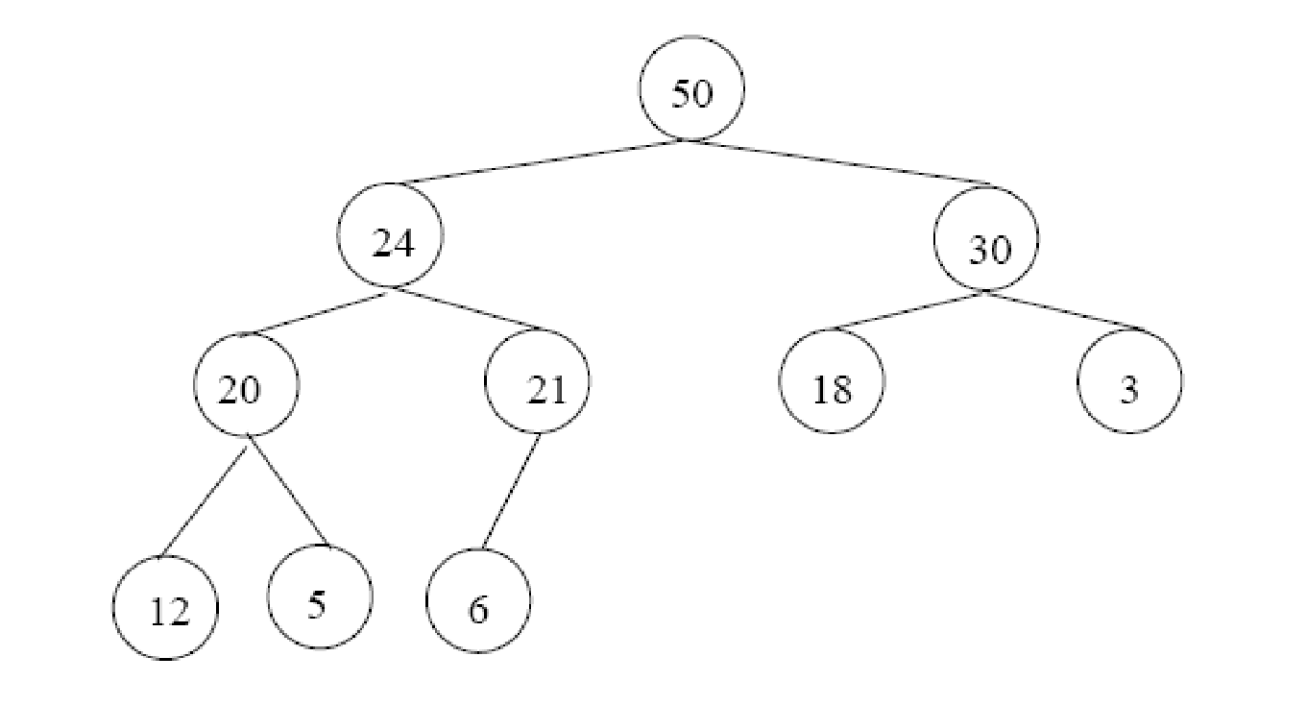
Adding/Deleting Nodes
New nodes are always inserted at the bottom level (left to right)
Nodes are removed from the bottom level (right to left)
‹#›
Notes:
‹#›

Slide 9
Operations on Heaps
Maintain/Restore the max-heap property
MAX-HEAPIFY
Create a max-heap from an unordered array
BUILD-MAX-HEAP
Sort an array in place
HEAPSORT
Priority queues
‹#›
Notes:
‹#›

Slide 10
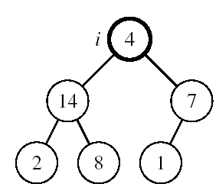
Maintaining the Heap Property
Suppose a node is smaller than a child
Left and Right subtrees of i are max-heaps
To eliminate the violation:
Exchange with larger child
Move down the tree
Continue until node is not smaller than children
‹#›
Notes:
‹#›

Slide 11
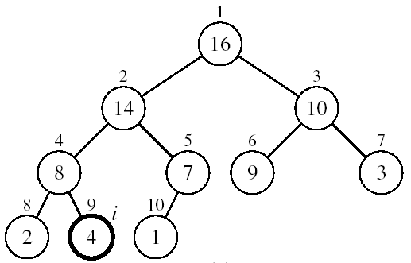
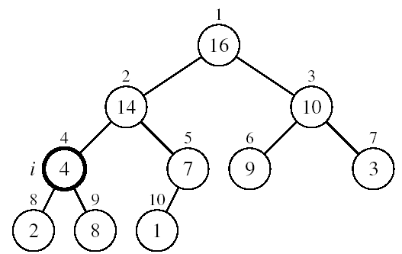
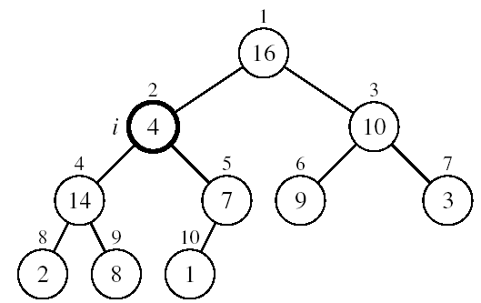
Example
MAX-HEAPIFY(A, 2, 10)
A[2] ↔ A[4]
A[2] violates the heap property
A[4] violates the heap property
A[4] ↔ A[9]
Heap property restored
‹#›
Notes:
‹#›

Slide 12
Maintaining the Heap Property
Alg: MAX-HEAPIFY(A, i, n)
l ← LEFT(i)
r ← RIGHT(i)
if l ≤ n and A[l] > A[i]
then largest ←l
else largest ←i
if r ≤ n and A[r] > A[largest]
then largest ←r
if largest ≠ i
then exchange A[i] ↔ A[largest]
MAX-HEAPIFY(A, largest, n)
Assumptions:
Left and Right subtrees of i are max-heaps
A[i] may be smaller than its children
‹#›
Notes:
‹#›

Slide 13
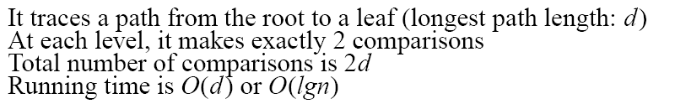
MAX-HEAPIFY Running Time
Intuitively:
Running time of MAX-HEAPIFY is O(lgn)
Can be written in terms of the height of the heap, as being O(h)
Since the height of the heap is ⎣lgn⎦
-
h
-
-
-
2h
O(h)
‹#›
Notes:
‹#›

Slide 14
Building a Heap
Convert an array A[1 … n] into a max-heap (n = length[A])
The elements in the subarray A[(⎣n/2⎦+1) .. n] are leaves
Apply MAX-HEAPIFY on elements between 1 and ⎣n/2⎦
Alg: BUILD-MAX-HEAP(A)
n = length[A]
for i ← ⎣n/2⎦ downto 1
do MAX-HEAPIFY(A, i, n)
1
4
2
3
1
3
4
5
6
7
2
16
9
10
8
9
10
14
8
7
A:
4 | 1 | 3 | 2 | 16 | 9 | 10 | 14 | 8 | 7
‹#›
Notes:
‹#›

Slide 15
Example: A
4 | 1 | 3 | 2 | 16 | 9 | 10 | 14 | 8 | 7
i = 5
i = 4
i = 3
1
1
1
4
4
4
2
3
2
3
2
3
1
3
1
3
1
3
4
5
6
7
4
5
6
7
4
5
6
7
2
16
9
10
2
16
9
10
14
16
9
10
8
9
10
8
9
10
8
9
10
14
8
7
14
8
7
2
8
7
i = 2
i = 1
1
1
1
4
4
16
2
3
2
3
2
3
1
10
16
10
14
10
4
5
6
7
4
5
6
7
4
5
6
7
14
16
9
3
14
7
9
3
8
7
9
3
8
9
10
8
9
10
8
9
10
2
8
7
2
8
1
2
4
1
‹#›
Notes:
‹#›

Slide 16
Procedure MaxHeapify
MaxHeapify(A, i)
1. l ← left(i)
2. r ← right(i)
3. if l ≤ heap-size[A] and A[l] > A[i]
4. then largest ← l
5. else largest ← i
6. if r ≤ heap-size[A] and A[r] > A[largest]
7. then largest ← r
8. if largest≠ i
9. then exchange A[i] ↔ A[largest]
10. MaxHeapify(A, largest)
Assumption:
Left(i) and Right(i) are max-heaps.
Comp 122

Slide 17
Running Time of BUILD MAX HEAP
Alg: BUILD-MAX-HEAP(A)
n = length[A]
for i ← ⎣n/2⎦ downto 1
do MAX-HEAPIFY(A, i, n)
O(n)
O(lgn)
⇒ Running time: O(nlgn)
This is not an asymptotically tight upper bound
‹#›
Notes:
‹#›

Slide 18
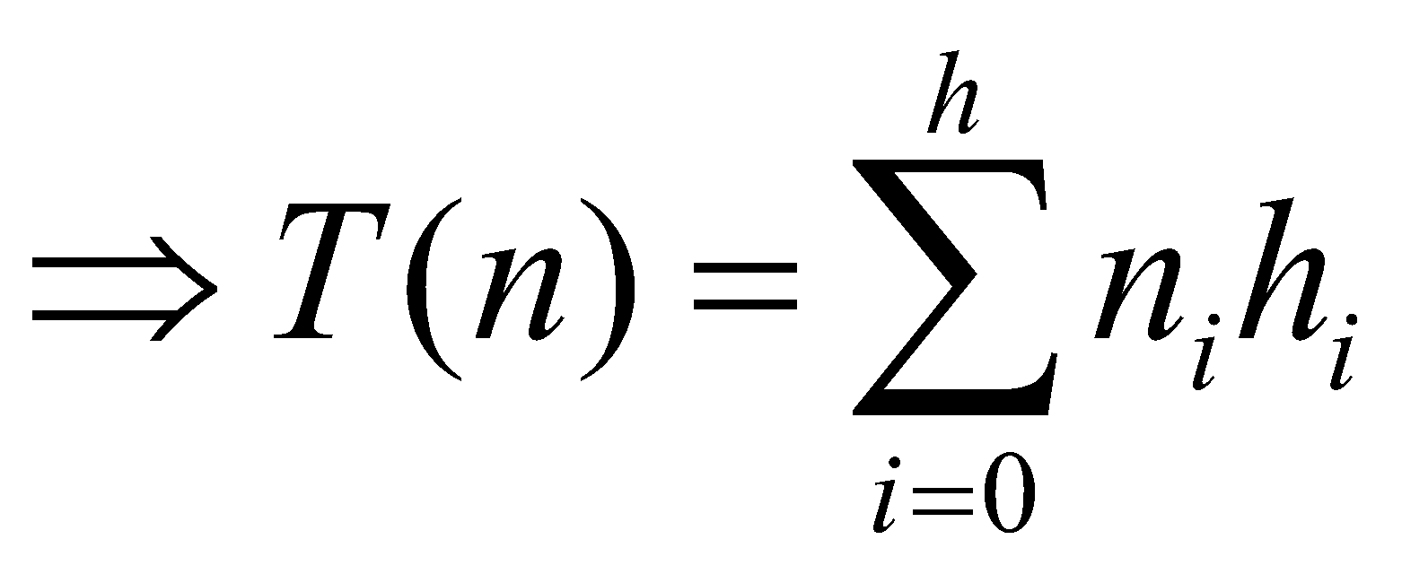
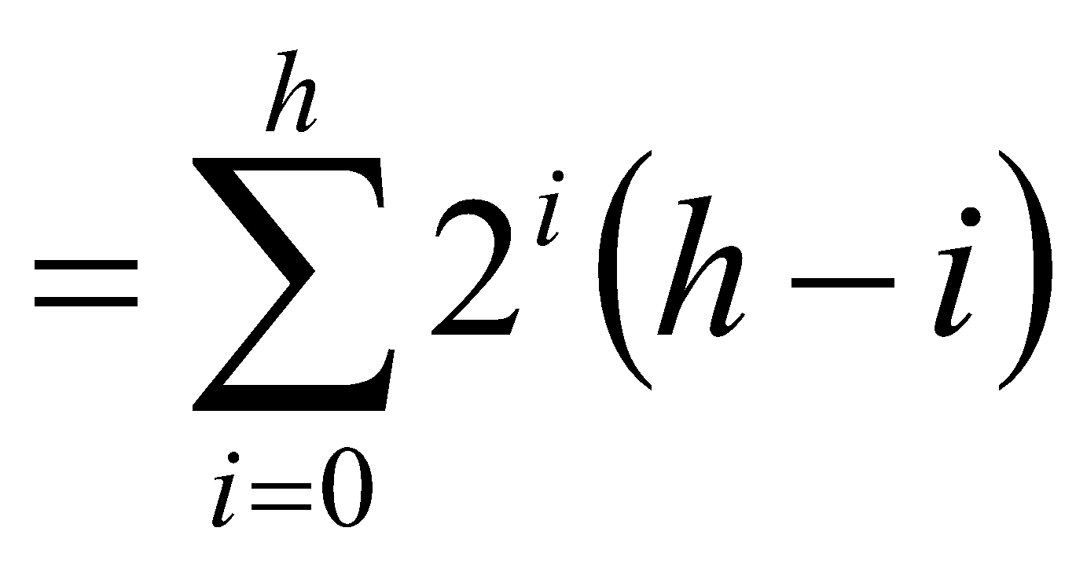
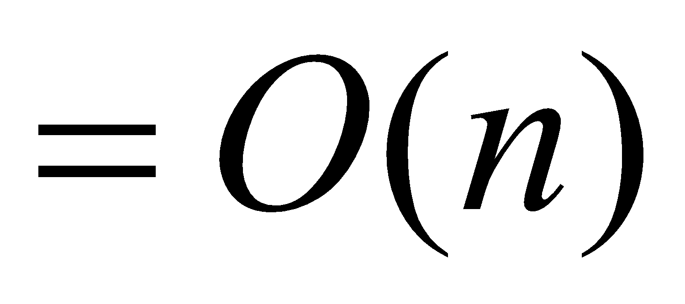
Running Time of BUILD MAX HEAP
HEAPIFY takes O(h) ⇒ the cost of HEAPIFY on a node i is proportional to the height of the node i in the tree
Height
Level
No. of nodes
h₀ = 3 (⎣lgn⎦)
i = 0
2⁰
h₁ = 2
i = 1
2¹
h₂ = 1
i = 2
2²
h₃ = 0
i = 3 (⎣lgn⎦)
2³
h_{i} = h – i height of the heap rooted at level i
n_{i} = 2^{i} number of nodes at level i
‹#›
Notes:
‹#›

Slide 19
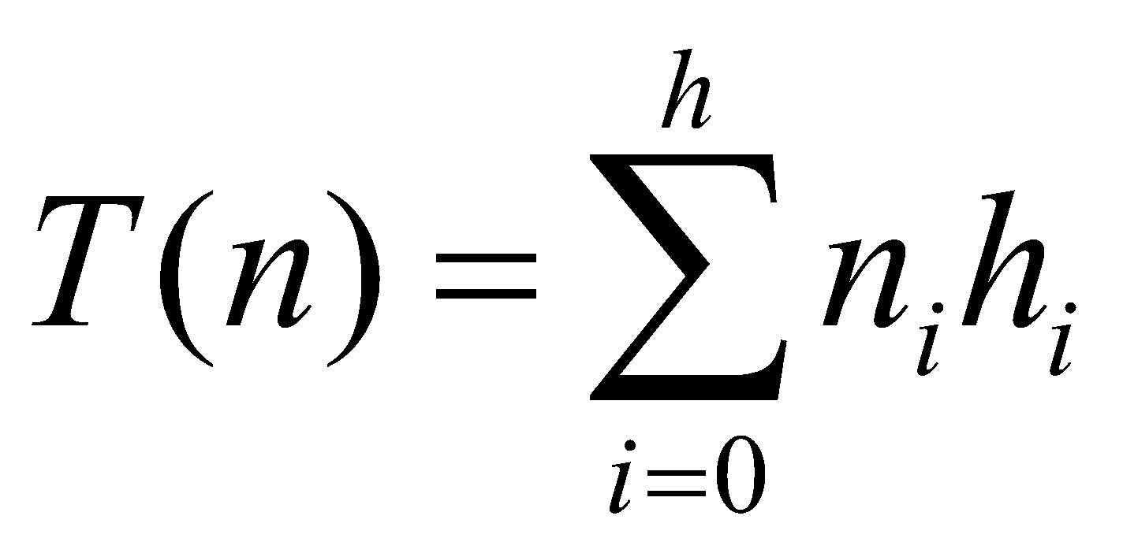
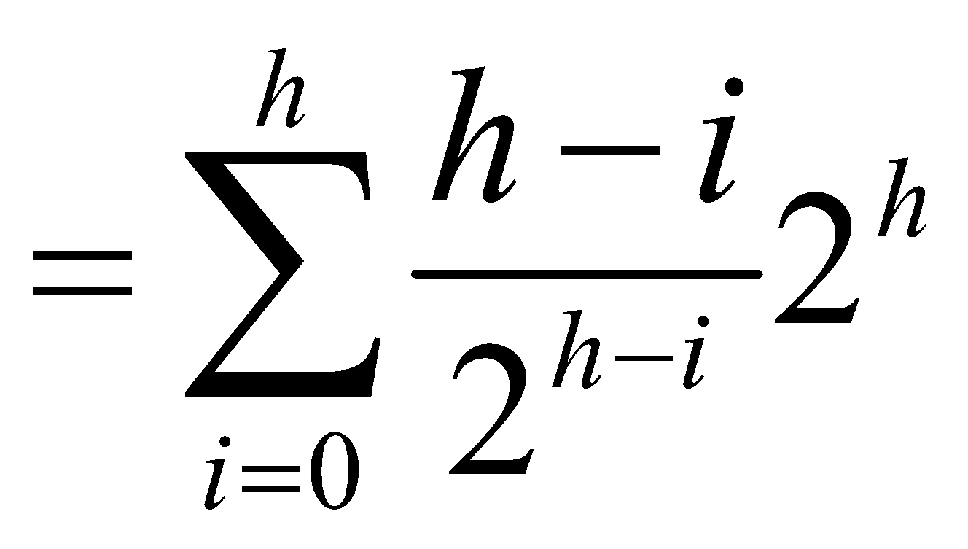
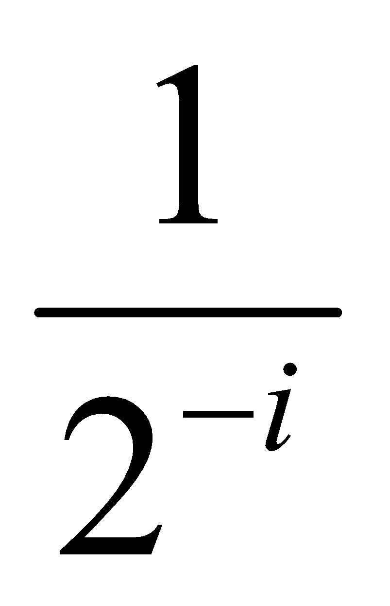
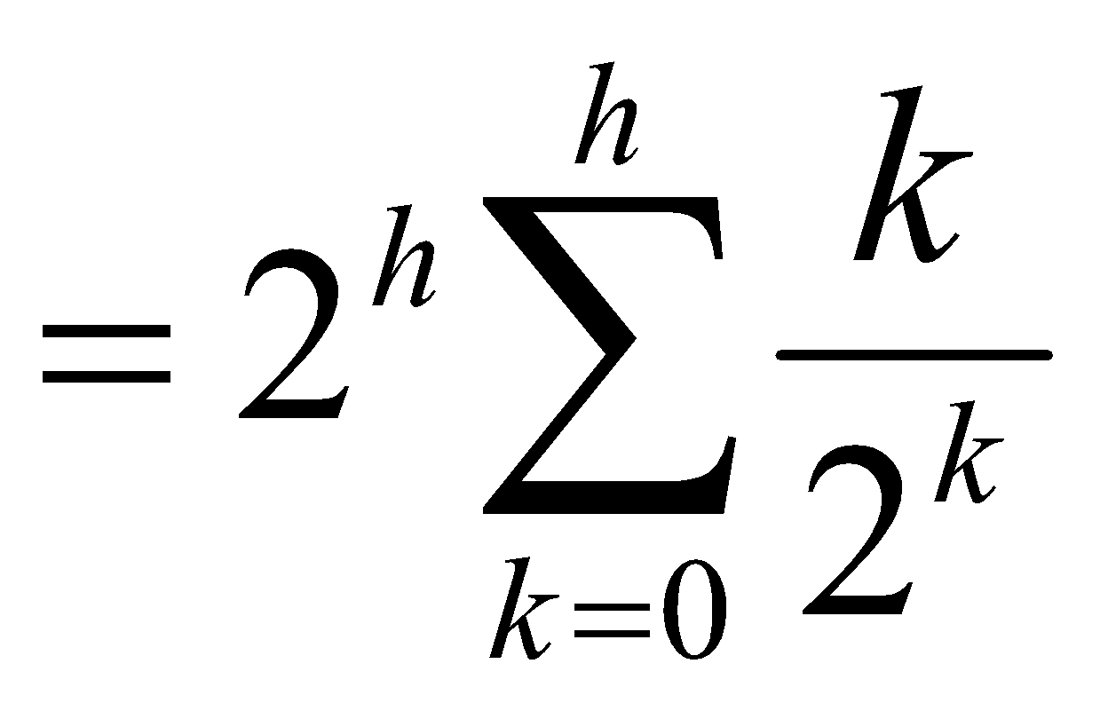
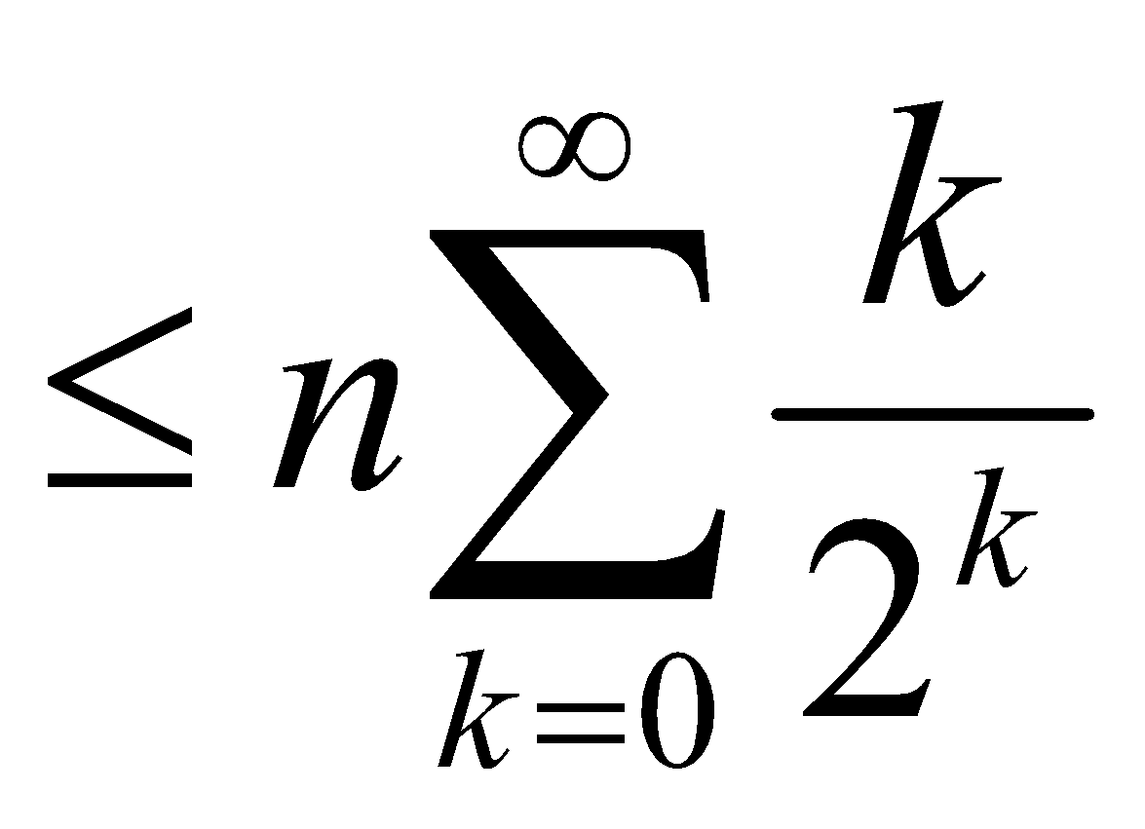
Running Time of BUILD MAX HEAP
Cost of HEAPIFY at level i * number of nodes at that level
Replace the values of n_{i} and h_{i} computed before
Multiply by 2^{h} both at the nominator and denominator and
write 2^{i} as
Change variables: k = h - i
The sum above is smaller than the sum of all elements to ∞
and h = lgn
The sum above is smaller than 2
Running time of BUILD-MAX-HEAP: T(n) = O(n)
‹#›
Notes:
‹#›

Slide 20
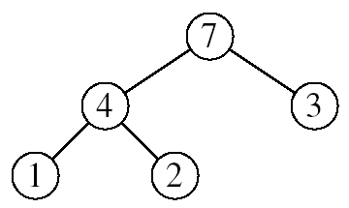
Heapsort
Goal:
Sort an array using heap representations
Idea:
Build a max-heap from the array
Swap the root (the maximum element) with the last element in the array
“Discard” this last node by decreasing the heap size
Call MAX-HEAPIFY on the new root
Repeat this process until only one node remains
‹#›
Notes:
‹#›

Slide 21

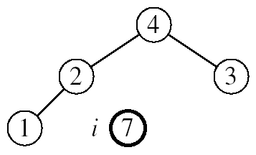
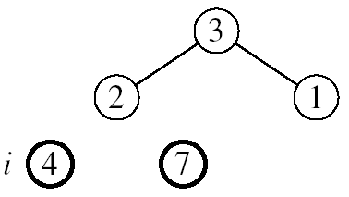
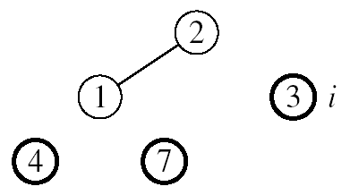
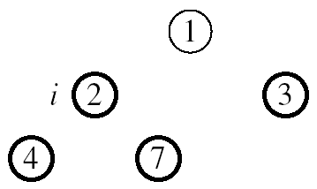
Example: A=[7, 4, 3, 1, 2]
MAX-HEAPIFY(A, 1, 4)
MAX-HEAPIFY(A, 1, 3)
MAX-HEAPIFY(A, 1, 2)
MAX-HEAPIFY(A, 1, 1)
‹#›
Notes:
‹#›

Slide 22
Alg: HEAPSORT(A)
BUILD-MAX-HEAP(A)
for i ← length[A] downto 2
do exchange A[1] ↔ A[i]
MAX-HEAPIFY(A, 1, i - 1)
Running time: O(nlgn) --- Can be shown to be Θ(nlgn)
O(n)
n-1 times
O(lgn)
‹#›
Notes:
‹#›

Slide 23
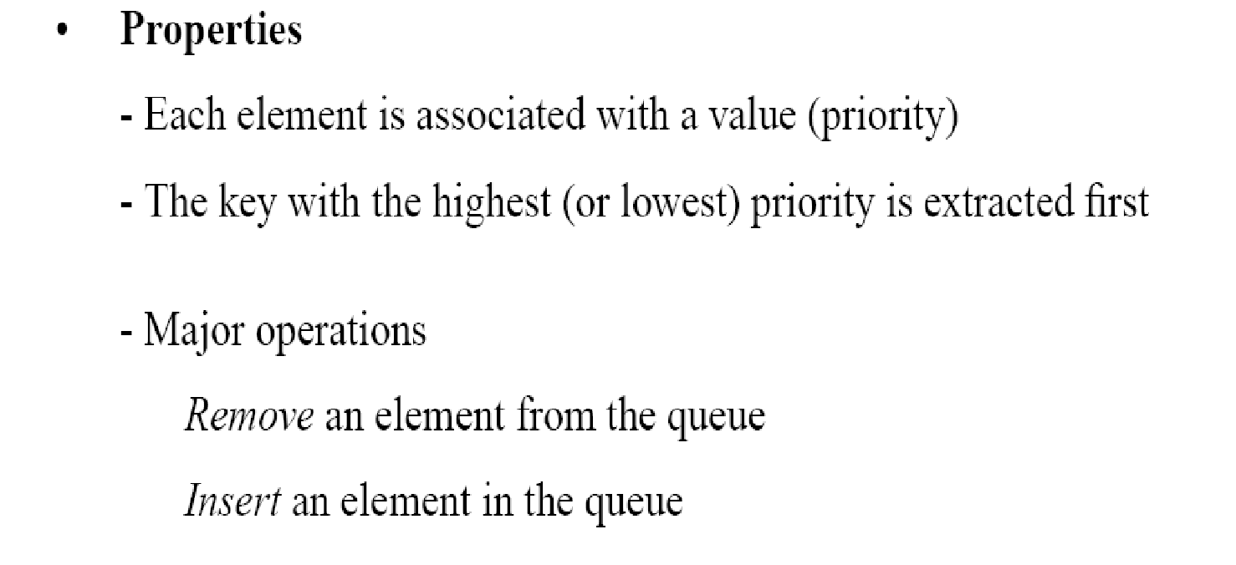
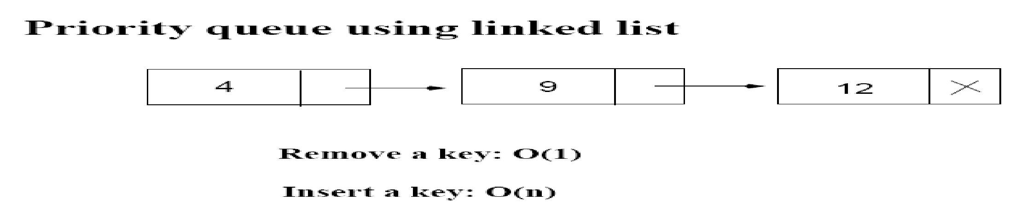
Priority Queues
12
4
‹#›
Notes:
‹#›

Slide 24
Operations on Priority Queues
Max-priority queues support the following operations:
INSERT(S, x): inserts element x into set S
EXTRACT-MAX(S): removes and returns element of S with largest key
MAXIMUM(S): returns element of S with largest key
INCREASE-KEY(S, x, k): increases value of element x’s key to k (Assume k ≥ x’s current key value)
‹#›
Notes:
‹#›

Slide 25
HEAP-MAXIMUM
Goal:
Return the largest element of the heap
Alg: HEAP-MAXIMUM(A)
return A[1]
Running time: O(1)
Heap A:
Heap-Maximum(A) returns 7
‹#›
Notes:
‹#›

Slide 26
HEAP-EXTRACT-MAX
Goal:
Extract the largest element of the heap (i.e., return the max value and also remove that element from the heap
Idea:
Exchange the root element with the last
Decrease the size of the heap by 1 element
Call MAX-HEAPIFY on the new root, on a heap of size n-1
Heap A:
Root is the largest element
‹#›
Notes:
‹#›

Slide 27
Example: HEAP-EXTRACT-MAX
16
1
14
10
max = 16
14
10
8
7
9
3
8
7
9
3
2
4
1
2
4
Heap size decreased with 1
14
Call MAX-HEAPIFY(A, 1, n-1)
8
10
4
7
9
3
2
1
‹#›
Notes:
‹#›

Slide 28
HEAP-EXTRACT-MAX
Alg: HEAP-EXTRACT-MAX(A, n)
if n < 1
then error “heap underflow”
max ← A[1]
A[1] ← A[n]
MAX-HEAPIFY(A, 1, n-1) remakes heap
return max
Running time: O(lgn)
‹#›
Notes:
‹#›

Slide 29
HEAP-INCREASE-KEY
Goal:
Increases the key of an element i in the heap
Idea:
Increment the key of A[i] to its new value
If the max-heap property does not hold anymore: traverse a path toward the root to find the proper place for the newly increased key
16
14
10
8
i
7
9
3
Key [i] ← 15
2
4
1
‹#›
Notes:
‹#›

Slide 30
Example: HEAP-INCREASE-KEY
16
16
14
10
14
10
8
i
7
9
3
8
i
7
9
3
2
4
1
2
15
1
Key [i ] ← 15
16
16
i
14
10
15
10
i
15
7
9
3
14
7
9
3
2
8
1
2
8
1
‹#›
Notes:
‹#›

Slide 31
HEAP-INCREASE-KEY
Alg: HEAP-INCREASE-KEY(A, i, key)
if key < A[i]
then error “new key is smaller than current key”
A[i] ← key
while i > 1 and A[PARENT(i)] < A[i]
do exchange A[i] ↔ A[PARENT(i)]
i ← PARENT(i)
Running time: O(lgn)
16
14
10
8
i
7
9
3
2
4
1
Key [i] ← 15
‹#›
Notes:
‹#›

Slide 32
MAX-HEAP-INSERT
Goal:
Inserts a new element into a max-heap
Idea:
Expand the max-heap with a new element whose key is -∞
Calls HEAP-INCREASE-KEY to set the key of the new node to its correct value and maintain the max-heap property
16
14
10
8
7
9
3
2
4
1
-∞
16
14
10
8
7
9
3
2
4
1
15
‹#›
Notes:
‹#›

Slide 33
Example: MAX-HEAP-INSERT
Insert value 15:
- Start by inserting -∞
Increase the key to 15
Call HEAP-INCREASE-KEY on A[11] = 15
16
16
14
10
14
10
8
7
9
3
8
7
9
3
2
4
1
-∞
2
4
1
15
The restored heap containing
the newly added element
16
16
14
10
15
10
8
15
9
3
8
14
9
3
2
4
1
7
2
4
1
7
‹#›
Notes:
‹#›

Slide 34
MAX-HEAP-INSERT
Alg: MAX-HEAP-INSERT(A, key, n)
heap-size[A] ← n + 1
A[n + 1] ← -∞
HEAP-INCREASE-KEY(A, n + 1, key)
16
14
10
8
7
9
3
2
4
1
-∞
Running time: O(lgn)
‹#›
Notes:
‹#›

Slide 35
Summary
We can perform the following operations on heaps:
MAX-HEAPIFY O(lgn)
BUILD-MAX-HEAP O(n)
HEAP-SORT O(nlgn)
MAX-HEAP-INSERT O(lgn)
HEAP-EXTRACT-MAX O(lgn)
HEAP-INCREASE-KEY O(lgn)
HEAP-MAXIMUM O(1)
Average
O(lgn)
‹#›
Notes:
‹#›

Slide 36
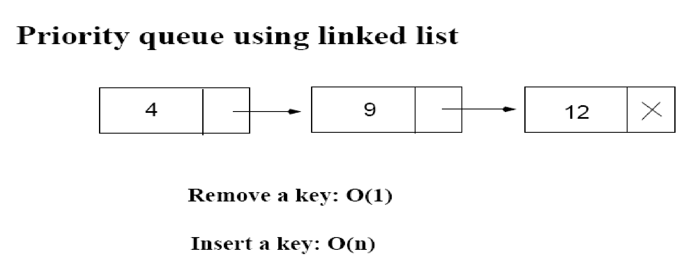
Priority Queue Using Linked List
12
4
Average: O(n)
Increase key: O(n)
Extract max key: O(1)
‹#›
Notes:
‹#›

Slide 37
Problems
Assuming the data in a max-heap are distinct, what are the possible locations of the second-largest element?
‹#›
Notes:
‹#›

Slide 38
Problems
(a) What is the maximum number of nodes in a max heap of height h?
(b) What is the maximum number of leaves?
(c) What is the maximum number of internal nodes?
‹#›
Notes:
‹#›

Slide 39
Problems
Demonstrate, step by step, the operation of Build-Heap on the array
A=[5, 3, 17, 10, 84, 19, 6, 22, 9]
‹#›
Notes:
‹#›

Slide 40
Problems
Let A be a heap of size n. Give the most efficient algorithm for the following tasks:
Find the sum of all elements
Find the sum of the largest lgn elements
‹#›
Notes:
‹#›

